Slide 1
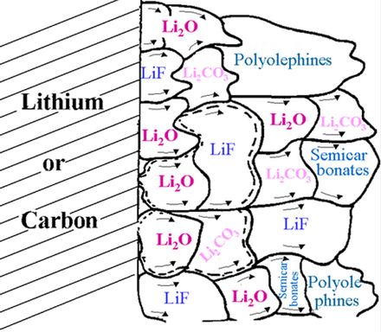
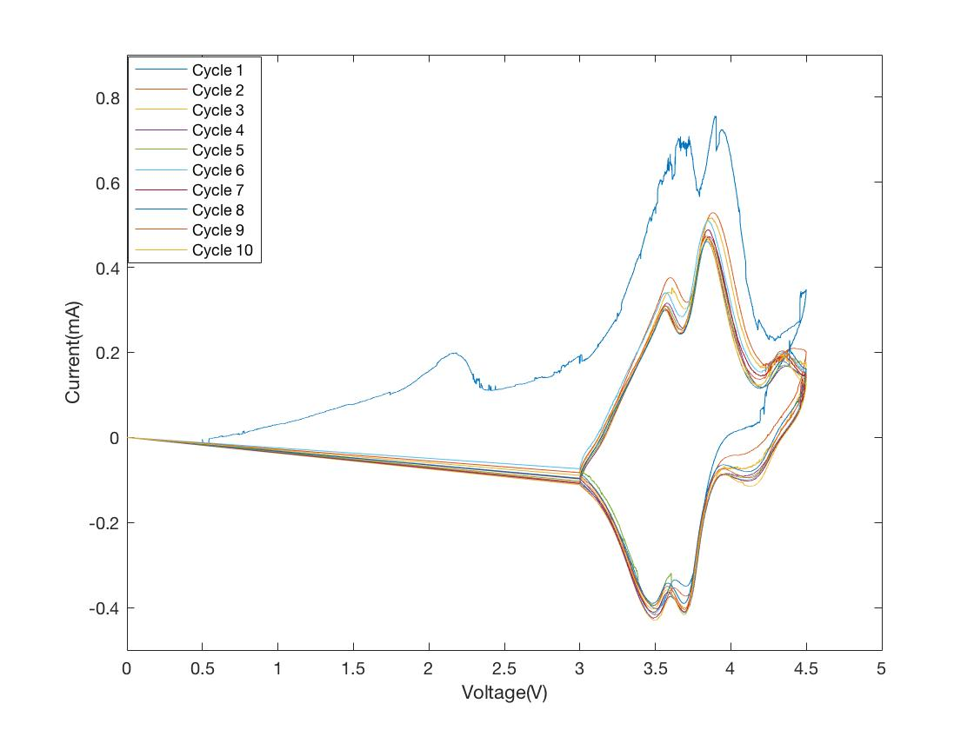
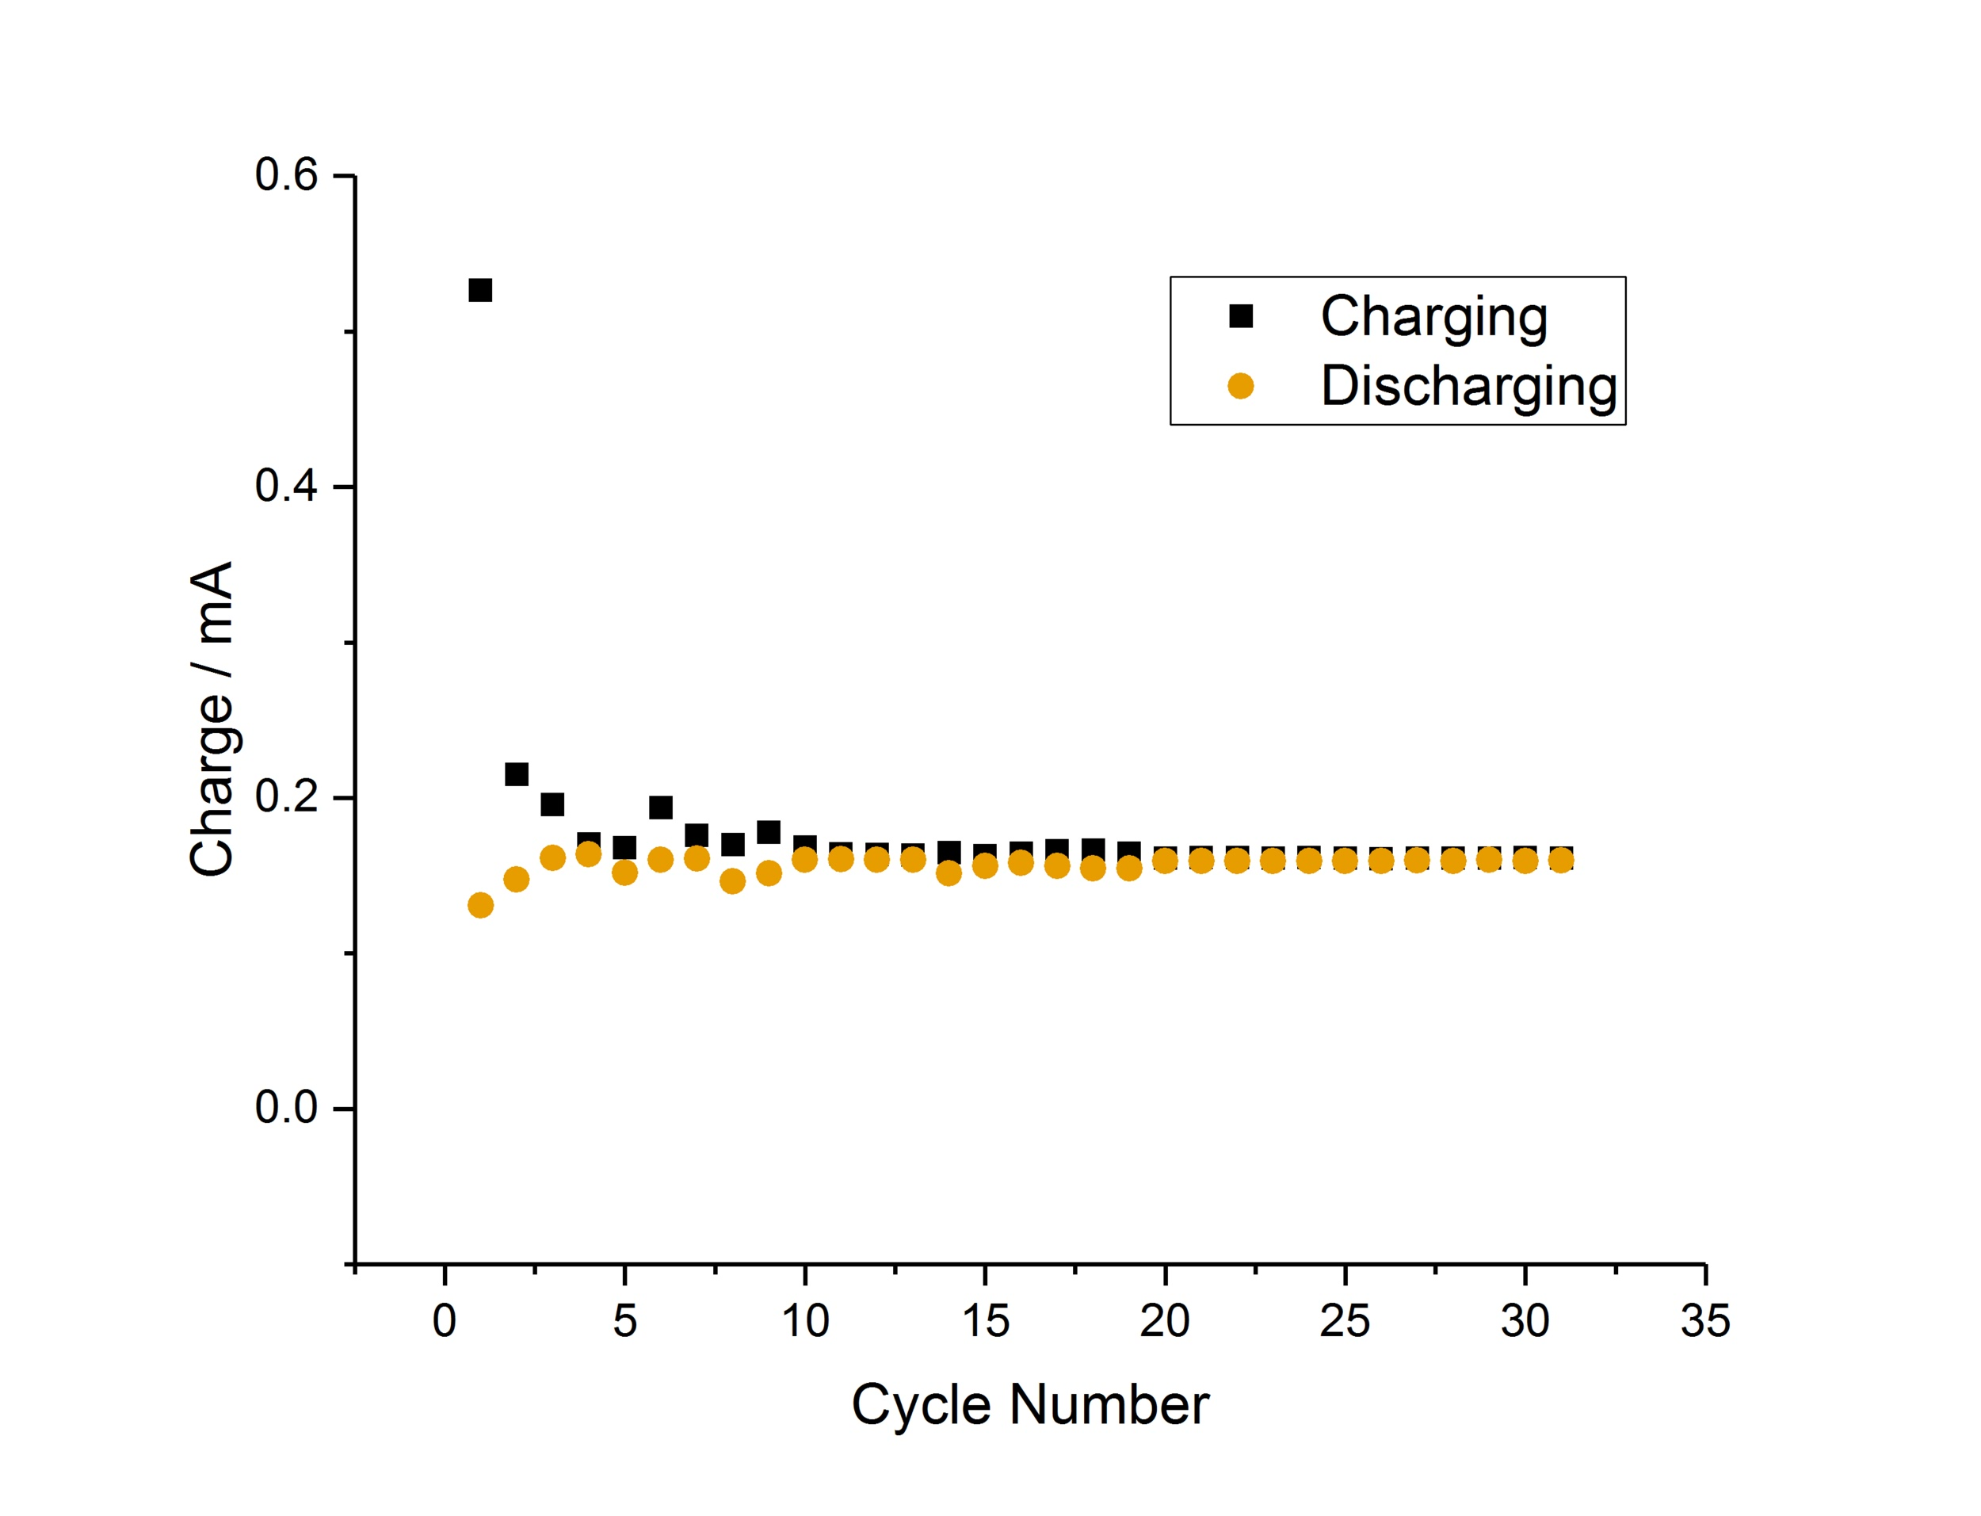

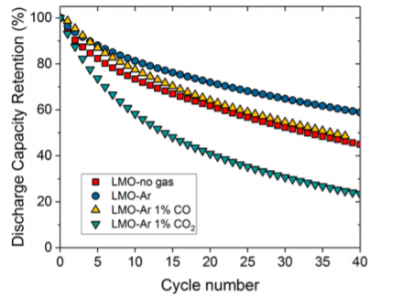
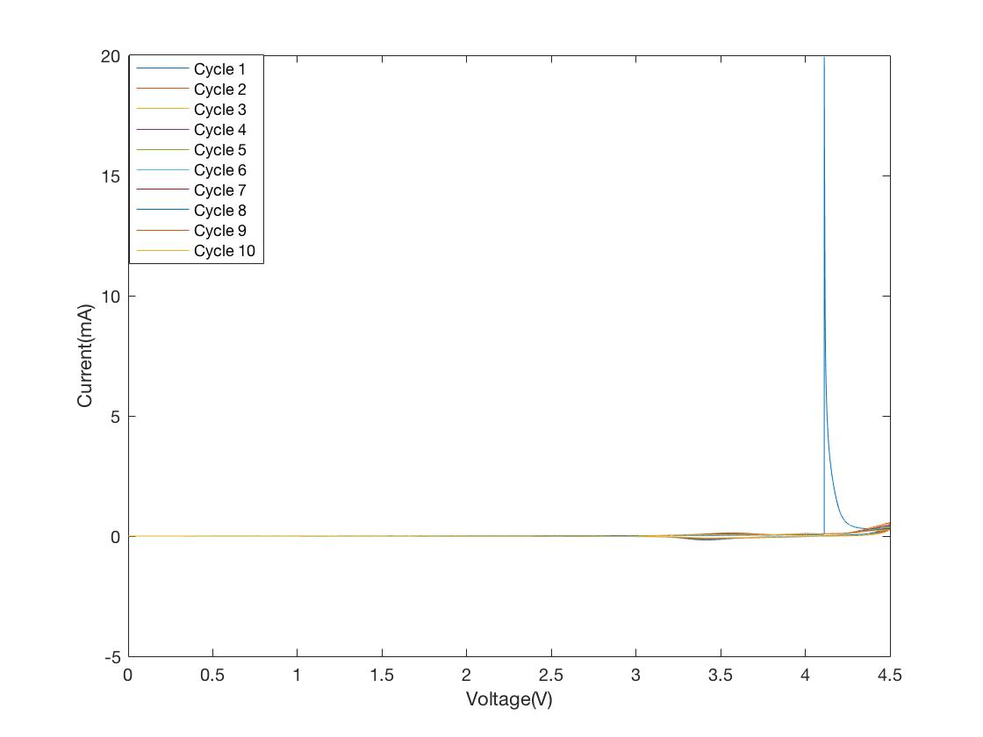
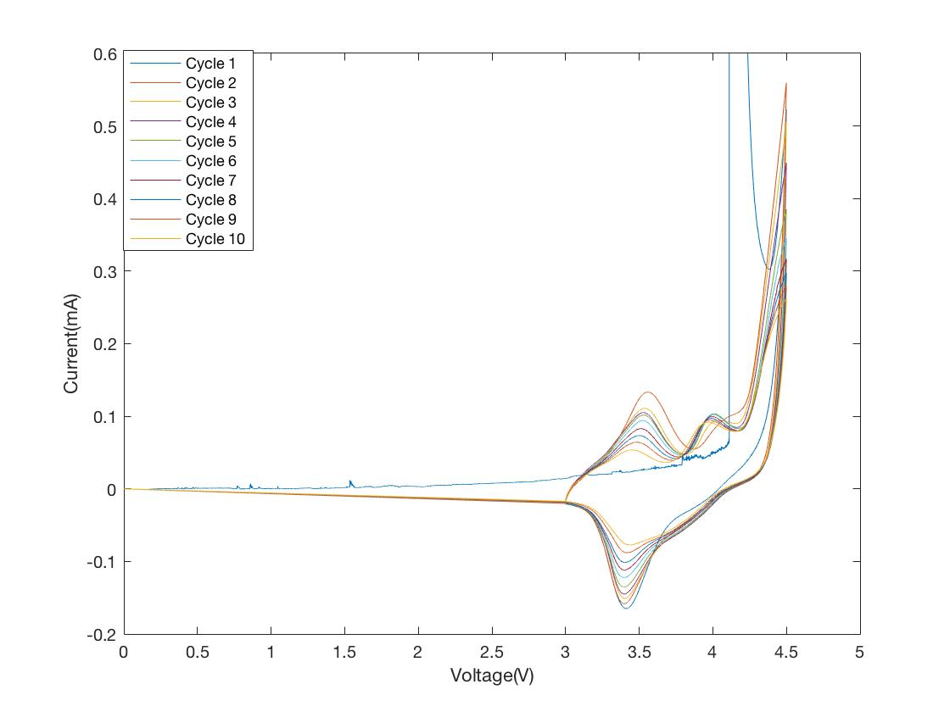
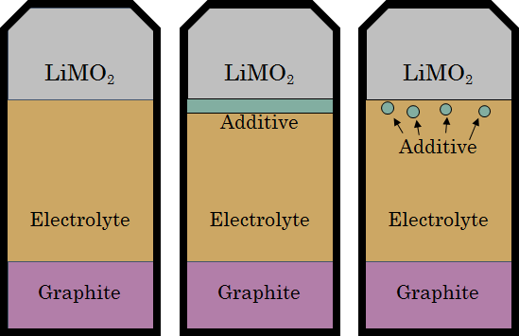
Additives for CO₂ Capture in Li Ion Batteries
Dan R., Vedant K., George L., Tony F. MSE 395
Benchmarking and Prototyping
A successful additive would result in a lower loss of charge over several cycles.
Gas absorption could be measured by BET, but no BET was available.
Three swageloc batteries were prepared- a baseline with no additive, a CaO additive, and a Li metal additive. Voltage was varied and current was measured using a potentiostat.
The Li metal additive battery had a short, and produced no data.
The CaO additive battery seems to have poor contact, producing unreliable and inconsistent data.
Mission Statement
Expand the lifetime of Li ion batteries by capturing the of CO₂ byproducts as a result of gas evolution with commercially available additives.
Background Information
Li-ion batteries consist of a Li-Metal oxide cathode, an electrolyte, and an anode, typically graphite.
The initial charge irreversibly produces a Solid Electrolyte Interface (SEI), schematically shown in Figure 1. This SEI formation is difficult to control and has a large impact on the overall battery performance.^{[1] [2]}
Thermodynamically, commonly used organic electrolytes are unstable and tend to decompose into a variety of gases.
The LiMO₂ reacts with the electrolyte to form lithium carbonate (Li₂CO₃) and CO₂ through the following reactions:^{[3]}
CO₂ is understood to lower battery cell cycle life, shown in Figure 2. ^{[4]}
Several potential additives have been shown to absorb CO₂, both organic and inorganic, including amines, CaO, and Li metal. ^{[5][6]}
Figure 1. Schematic of the SEI. It is made up of a variety of different compounds, making it difficult to predict. [2]
Design
To determine how much additive is needed, the theoretical amount of CO2 generated must be determined.
Several assumptions^{[1][2][7]}
SEI is 5 nm thick
SEI is entirely Li₂CO₃
All Li₂CO₃ decomposes to CO₂
These assumptions result in an overestimation.
Commercial batteries typically have within the range of 20 m² of LiCoO₂^{[7]}
Therefore, 1.25 x 10⁻³ moles of CO₂ are generated, requiring 0.0702 g CaO, 0.153 g MEA, 0.130 g AEEA (amines), or 0.0116 g Li.
Focused on CaO and Li due to safety concerns
Additive needs to be near the cathode to capture most CO₂ as it is generated
Figure 4. Current as a function of voltage for the baseline battery with no additives (Left). Electric charge during charging and discharging as a function of cycle number (Right). After a number of cycles, the SEI reaches a moderately stable state, stabilizing the electrical properties of the battery.
Figure 5. Current as a function of voltage for the baseline battery with no CaO unscaled (Left) and zoomed in (Right). We suspect that the battery did not have a good internal connection, and that the CaO acted as a partial insulator.
Figure 2. Discharge capacity retention over many cycles under various conditions. CO₂ greatly reduced the efficacy of the battery. ^{[4]}
Conclusions
CO₂ gas generated in Li Ion batteries can theoretically be chemically captured.
Capture additives must be disperse enough as to not interfere with the battery chemistry.
Design Constraints
Must be able to physically fit inside current battery dimensions, preferably available in powder form.
Must not insulate the internal electrical connections.
Must be safe to dispose of.
Must not react with the electrolyte.
References and Bibliography
[1] Seong Jin An et al, “The state of understanding of lithium-ion-battery graphite solid electrolyte interphase (SEI) and its relationship to formation cycling”, Carbon 105 (2016) p.52-76
[2] Peled, E. & Menkin, S. Review—SEI: Past, Present and Future. Journal of The Electrochemical Society 164, A1703-A1719 (2017).
[3] Andreas Wuersig, “CO2 Gas Evolution on Cathode Materials for Lithium-Ion Batteries”, Journal of the Electrochemical Society, 154 (5), A4449-A454 (2007)
[4] Tang, Ching-Yen et al. "Insights Into Solid-Electrolyte Interphase Induced Li-Ion Degradation From In Situ Auger Electron Spectroscopy." The Journal Of Physical Chemistry Letters, vol 8, no. 24, 2017, pp. 6226-6230. American Chemical Society (ACS), doi:10.1021/acs.jpclett.7b02847.
[5] Dash, Sukanta K. “Post Combustion Carbon Dioxide Capture Using Amine Functionalized Carbon Nanotubes: A Review.” 2016, doi:10.1063/1.4945237.
[6] Wang, Fei, et al. “Carbon Dioxide Absorption and Release Properties of Pyrolysis Products of Dolomite Calcined in Vacuum Atmosphere.” The Scientific World Journal, Hindawi, 16 July 2014, www.hindawi.com/journals/tswj/2014/862762/.
[7] Powder, L. Lithium Cobalt Oxide (LiCoO2) Powder. www.novarials-store.com (2018). at <https://www.novarials-store.com/products/lithium-cobalt-oxide>
[8] M. Holzapfel, W. Scheifele, “Oxygen, hydrogen, ethylene and CO2 development in lithium-ion batteries”, Journal of Power Sources, vol 174, is 2 (2007) p. 1156-1160
[9] J. Vetter, “In situ study on CO2 evolution at lithium-ion battery cathodes”, Journal of Power Sources, vol 159, is 1 (2006) p. 277-281
[10] Benson, Sally M., and Franklin M. Orr. "Carbon Dioxide Capture And Storage." MRS Bulletin, vol 33, no. 04, 2008, pp. 303-305. Cambridge University Press (CUP), doi:10.1557/mrs2008.63.
[11] John . Goodenough and Kyu-Sung Park, “The Li-Ion Rechargeable Battery: A Perspective”, Journal of the American Chemical Society (2013) p.1167 - 1176
[12] Riccardo Ruffo, Colin Wessells, Robert A Huggins, Yi Cui, “Electrochemical behavior of LiCoO₂ as aqueous lithium-ion battery electrodes”, Electrochemistry Communications 11 (2009) p. 247-249
Figure 3. Schematics of traditional Li Ion batteries (Left), a Li Ion battery with an additive layer between the LiMO₂ (Middle), and a Li Ion battery with additive dispersed in the electrolyte near the LiMO₂ (Right). A layer of additive is easier and allows for more CO₂ capture, but the dispersed additive would be less invasive on the electrical properties.
FIGURE TEXT
Notes:
Design- idea for compartmentalizing, calculation,

